Slide 1




Sweet Temptations: How To Catch the Hackers
Matt Boddy @infosecBoddy
Notes:
Introduction
What we’ll cover
How we at Sophos have used honeypots to help enhance sales and marketing efforts
How could a honeypot be setup in a clients environment
A practical hands on ‘how to’ setup a honeypot and hack it.

Slide 2


Slide 3

314,341
Login attempts
616,232
437,250
Login attempts
Login attempts
953,736
572,618
Login attempts
612,885
Login attempts
Login attempts
312,928
Login attempts
336,944
678,013
Login attempts
Login attempts
613,009
Login attempts
Statistics taken over a 30 day period

Slide 4

Default usernames & passwords
Username | Login attempt count
root | 5,211,644
admin | 47,816
user | 6,345
ubnt | 5,469
ubuntu | 2,585
nagios | 2,520
pi | 2,217
postgres | 1,748
Password | Login attempt count
123456 | 15,735
admin | 12,605
1234 | 9,583
password | 9,034
12345 | 7,145
ubnt | 6,137
root | 5,767
123 | 5,433
 | 3,248
raspberry | 1,808
Taken from 10 honeypots over a 30 day period
Notes:
Password defaults
123456 - CCTV cameras
Admin – CCTV cameras & routers & NAS
1234 – CCTV cameras
Password – NAS
12345 – Panasonic CCTV
Ubnt – ubiquity networks
Root – D-max cctv cameras
123 – YooSee CCTV
blank – Microtik routers & Axis/Vivotek IOT
Raspberry – Raspbian

Slide 5
What is a honeypot? – Low interaction

Slide 6


Slide 7
What is a honeypot? – High interaction

Slide 8


Slide 9
How can a honeypot be used in a clients environment?

Slide 10
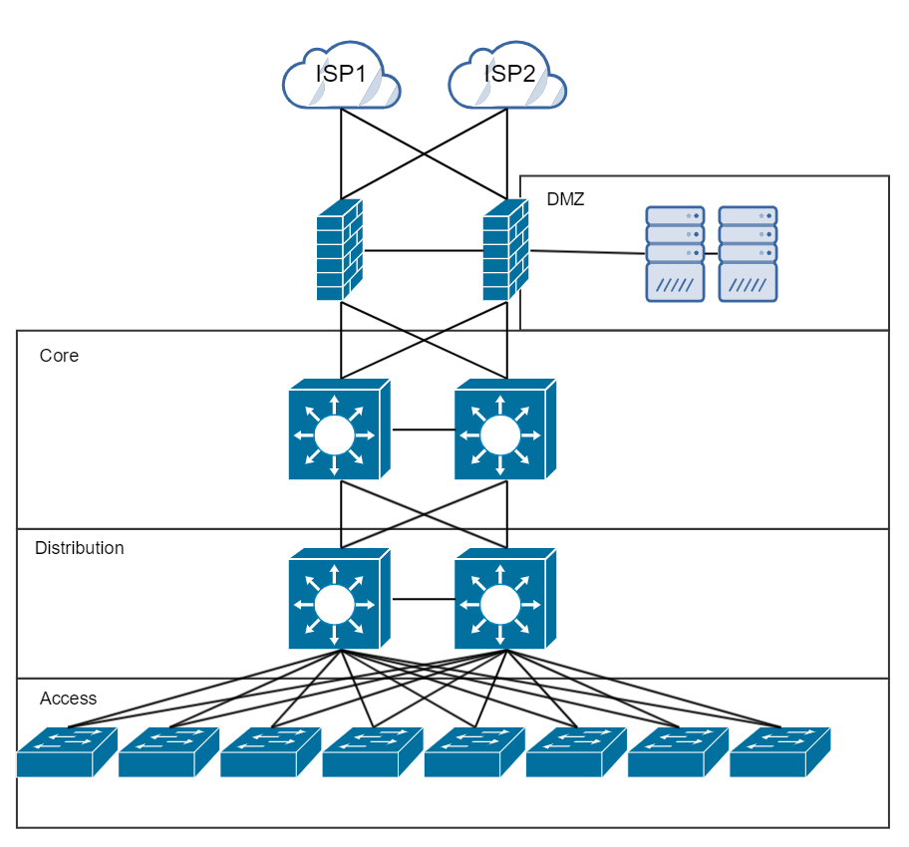
An enterprise network

Slide 11
What we’ll be setting up

Slide 12


Prerequisites
Please make sure that you’ve got all of the following installed.
Python 3
Python 3 IDE (I’m using IDLE)
A means to SSH (Putty, Powershell, Mac command line, Bash etc.)
pip

Slide 13


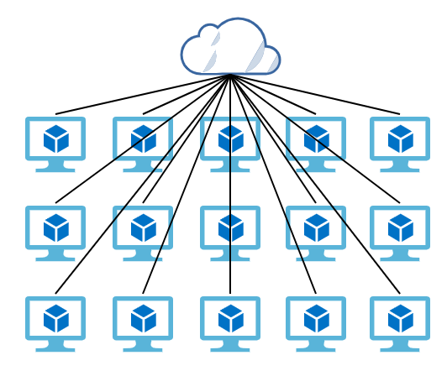
1. SSH Honeypot in Azure
For the duration of this session, you have a virtual Ubuntu server hosted in Azure.
Follow printed instructions to setup your honeypot!
Lock your honeypot down so that it can only be logged into by one of the pre-defined username & password combos

Slide 14


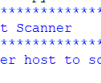
2. Enumerating a honeypot!
Following your guide, create a Python script to port scan your neighbours honeypot.

Slide 15
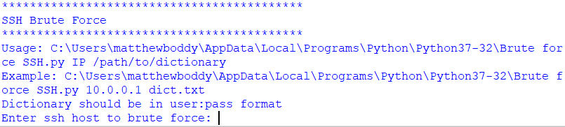
3. Brute force attack a honeypot!
Following your guide, create a Python script to brute force onto your neighbours honeypot

Slide 16
Sweet Temptations: How To Catch the Hackers
Matt Boddy @infosecBoddy
Notes:
Introduction
What we’ll cover
How we at Sophos have used honeypots to help enhance sales and marketing efforts
How could a honeypot be setup in a clients environment
A practical hands on ‘how to’ setup a honeypot and hack it.

